Slide 1
Therapeutic Potentials of Cord Blood Mononuclear Cells Transplantation for Limb Ischemia:
a Comparison Between CD34+ and CD34- Cells.

Slide 3
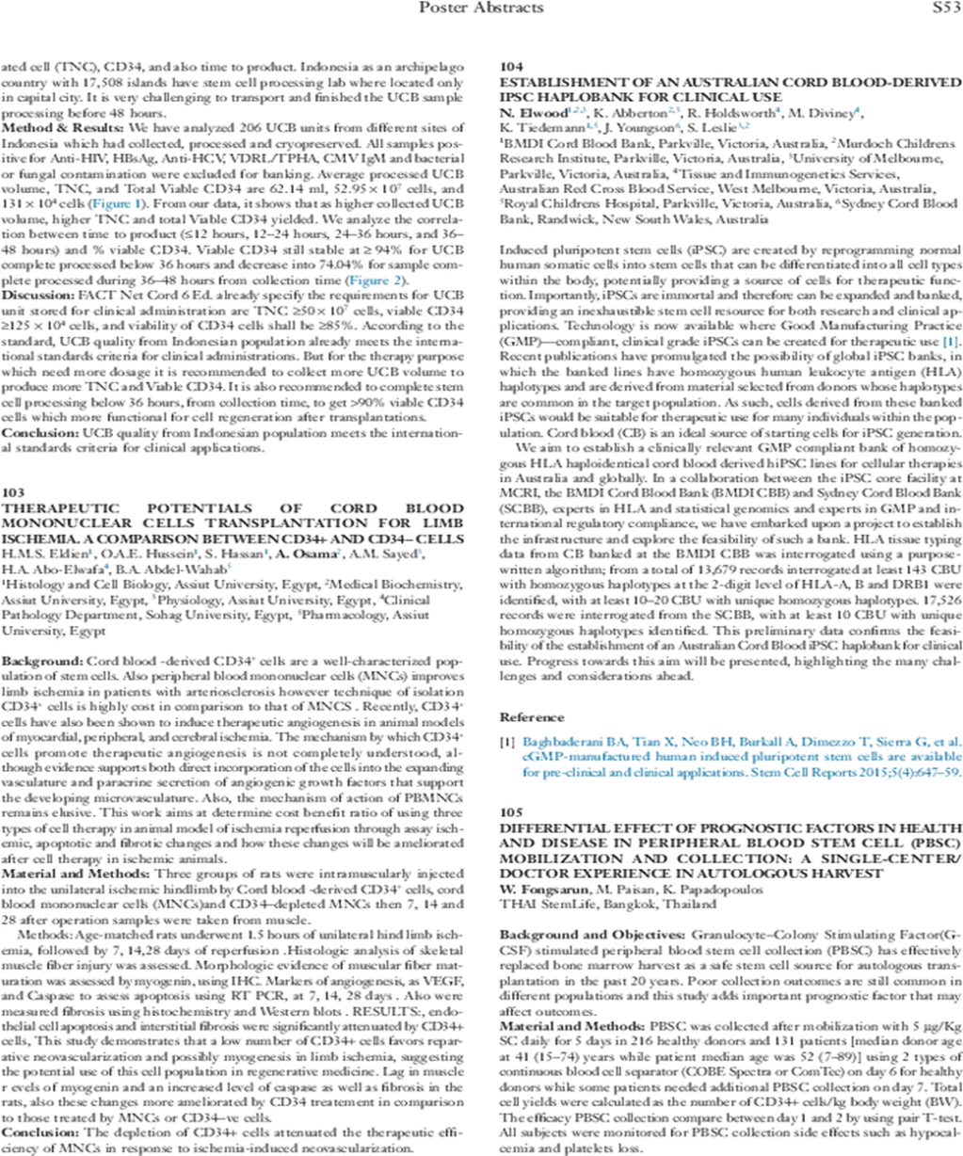

Slide 4
Background:
The therapeutic potential of cord blood grow over the last few days .
Regenerative medicine is the science of which the living cells being used to facilitate repair tissue damage ( genetic, injury or aging).
In young patients it change the untreatable condition as autism.

Slide 5
Regenerative medicine promises some extraordinary medical possibility.
Today it can be use for:
Burns, liver diseases, heart disease, peripheral limb ischemia, autism, brain injury, multiple sclerosis, cerebral palsy, stroke, Parkinson's disease, heart attack, bone fracture, DM.

Slide 6
Source of regenerative ‘stem’ or progenitor cells—for example, hematopoietic progenitor cells (HPCs) and mesenchymal stem cells (MSCs)—for use against many .human diseases (Santiago etal, 2015)

Slide 7
Stem cells are also considered to be a cornerstone of new area of science known as regenerative medicine.
In the near future , stem cells will provide cure for common and life threating conditions : heart disease, Alzheimer’s and DM.

Slide 8
Types of stem cells:
Broadly speaking, the main types of stem cells, embryonic and non-embryonic.
Embryonic stem cells (ESCs) are derived from the inner cell mass of the blastocyst and can differentiate into cells of all three germ layers.
However teratoma formation and ethical controversy hamper their research and clinical application

Slide 9
On the other hand, non-embryonic stem cells, mostly adult stem cells, are already somewhat specialized and have limited differentiation potential. They can be isolated from various tissues and are currently the most commonly used seed cells in regenerative medicine.

Slide 10
Recently, another type of non-embryonic stem cells, known as induced pluripotent stem cell (iPSCs) has emerged as a major breakthrough in regenerative biology. They are generated through enforced expression of defined transcription factors, which reset the fate of somatic cells to an embryonic stem-cell-like state

Slide 11
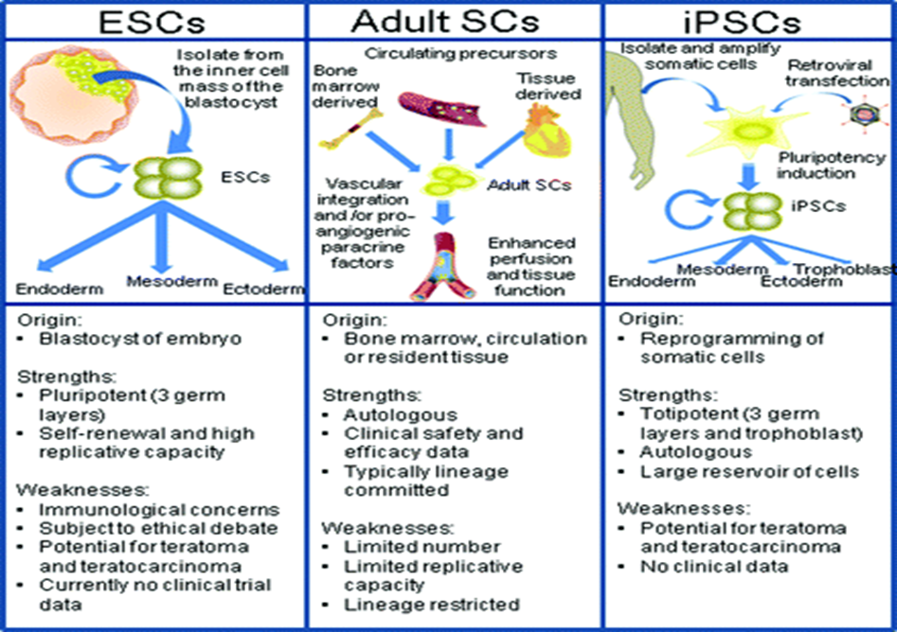
Fig (1): Types of Stem Cells , ESCs embryonic stem cells, iPSCs induced pluripotent stem cells. Leeper et al,( 2010), Circulation. 2010;122:517-526

Slide 12
Cord blood stem cells are a precious resource that have been saving lives for over 20 years. There have been more than 1 million stem cells treatments worldwide.
The Umbilical cord blood stem cells are the recognized therapy for 80 diseases.
These include:
Blood disease: aplastic anemia, FA, leukemia, lymphoma.
Cancer: solid tumor: neuroblastoma
Immune disorder : SCID, Wiskott-Aldrich syndrome.

Slide 13
Inborn error metabolism: Gucheur.
C.N.S: Myopathy, neurodegenerative disease, cerebral palsy. Autism, Spinal cord injury
Heart disease, MI, PLI.

Slide 14
Umbilical cord blood contains millions of hematopoietic stem cells ( HPSCs).
These type of stem cells can transform to any type of blood cells.
So cord blood can be to rebuild the immune system in patients with advanced cancer whom taken chemotherapy.

Slide 15
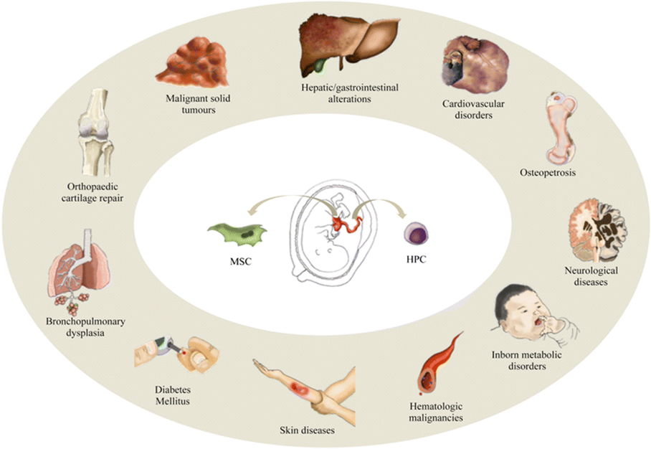
Fig (2): Current clinical applications of umbilical cord blood. Stem Cell Research & Therapy2015 6 :123

Slide 16
Cord blood registry : CBR 1992 south California regulated clinical trials approved by FDA about 500,000 families are members used the baby cord blood.
Accredited by AABB American Association of Blood Banking .
They use seamless cryo bag to avoid breakige

Slide 17
When you bank your child( baby) cord blood?
1- Autologous stem cell transplantations
2- Sibling , more suitable than allogeneic transplantation.

Slide 18
Cord blood -derived CD34⁺ cells are a well-characterized population of stem cells. Also mononuclear cells (MNCs) improves limb ischemia in patients with arteriosclerosis . (Santiago et al, 2015) Stem Cell Research & Therapy20156:123

Slide 19
Transplantation of HPSCs CD34+ cells from cord blood needs the presence of MSCs for expansion in cytotherapy , feeder layer decrease apoptosis ( Roya Mehrasa etal, 2014)

Slide 20
Critical limb ischemia (CLI) represents the most advanced stage of peripheral arterial disease (PAD) with a markedly reduces blood flow to the extremities and has progressed to the point of severe rest pain Critical limb ischemia (CLI) is an important condition in the general population with a strong social impact and/or even tissue loss (Strauss B. H,2013).

Slide 21
Recent therapeutic strategies have focused on restoring this tissue survival using exogenous cellular agents to promote regeneration of the vasculature. These are based on stimulation of angiogenesis
Intramuscular and intra-arterial injection or a combination of both may be proposed in the treatment of human PAD. The principle of intramuscular injection is the creation of a cell depot with paracrine activity in the ischemic area ( Liao etal,2013).

Slide 22
Injection of bone marrow mononuclear cells has been reported to promote neovascularization of ischemic tissues effectively. This angiogenic effect may be related to their ability to induce vascular and muscle regeneration by paracrine mechanisms through vascular endothelial growth factor secretion. Bone marrow mononuclear cells (BM-MNCs) release various angiogenic factors ( Rita etal, 2015).

Slide 23


Slide 24
FCM markers for stem cells:
1-Hematopoietic stem cell ( HPSCs) isolated from P.Bl, B.M or umbilical cord .
Positive for CD34+ve , CD45+ve
2-MSCs : isolated from adipose tissue, placenta, umbilical cord , B.M and tooth bulb .
Negative for CD34, CD45, CD19, CD3, CD11b, HLA-DR
Positive for CD90, CD271 CD71, CD105,CD73, CD44

Slide 25
However technique of isolation CD34⁺ cells is highly cost in comparison to that of MNCS. Recently, CD34⁺ cells have also been shown to induce therapeutic angiogenesis in animal models of myocardial, peripheral, and cerebral ischemia. (Gopall et al, 2010).Cite this article as: BJMP 2010;3(4):a345

Slide 26
The mechanism by which CD34⁺ cells promote therapeutic angiogenesis is not completely understood, although evidence supports both direct incorporation of the cells into the expanding vasculature and paracrine secretion of angiogenic growth factors that support the developing microvasculature. (Grande et al, 2015 ) Stem Cell Int.

Slide 27
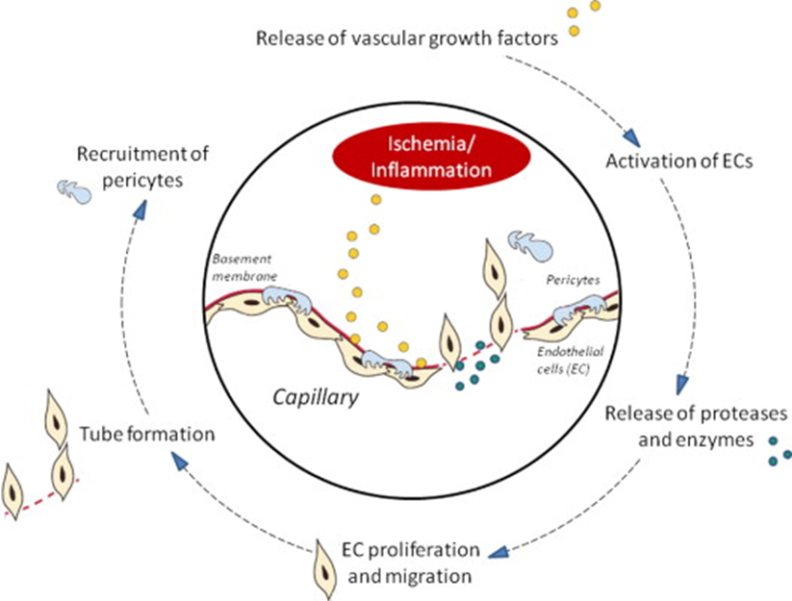
Figure 3: Schem of possible events in the angiogenic process. EC, endothelial cell.
( Lawall et al. Autologous stem cell therapy 2010) Thrombosis and Haemostasis 103.4/2010

Slide 28
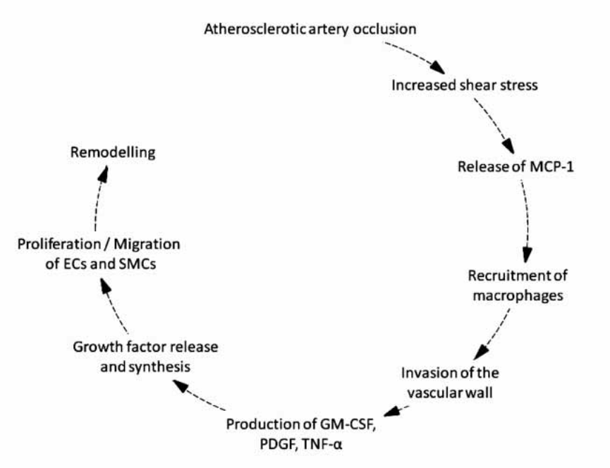
Fig(4): Schema of angiogenesis events . (EC: endothelial cell; SMC: smooth muscle cell; MCP-1: monocyte chemoattractant protein-1; GM- CSF: granulocyte -macrophage colony-stimulating factor; PDGF platelet derived growth factor; TNFα, tumour necrosis factor-α. ( Lawall et al. Autologous stem cell therapy 2010) Thrombosis and Haemostasis 103.4/2010

Slide 29
Aim:
To study benefit of three types of cell therapy in limb ischemia / reperfusion model through assay ischemic, apoptotic, fibrotic and angiogenesis events before and after cell therapy .

Slide 30
Methods :
The study was done at Molecular Biology and Cell Culture Unit of Assiut University.
During the period from May 2015 to May 2017
It was approved by institutional research committee.

Slide 31
Methods :
Three groups of age matched rats were subjected to unilateral hind limb ischemia for 1.5 hours, serum myoglobin, CK were assayed, 3 hours after reperfusion

Slide 32
Cord blood CD34+ cells , MNCs, and depleted CD34 cells were isolated by Ficoll™ , polysaccharide based density for MNCs , magnetic probe for CD34+.
Identified by BD FCM eight color (USA) using monoclonal Abs to CD34 .
Expanded on DEMEM, cryopreserved till use

Slide 33
Intramuscular injection by cord blood CD34⁺ cells, cord blood (MNCs) and CD34 depleted MNCs
Then 7, 14 and 28 days after operation muscle biopsy were taken , Caspase, HLA- ABC, VEGF, using RT-PCR, myogenin using IHC

Slide 34
The number of injected concentrated mononuclear cells (MNCs) in PAD between 0.3x10⁹ to 2 x 10⁹ MNCs The percentage of implanted CD34+ cells is usually between 0.6% and 2.4% of total implanted MNC .
( 2.5X10 6 CD 34 +) increase therapeutic effect. Associated with fever , post transfusion syndrome, decrease hematopoietic reserve

Slide 35


Slide 36
Results :
Endothelial cell apoptosis and interstitial fibrosis were significantly attenuated by cord blood CD34+ cells, and (MNCs), the depletion of CD34 attenuates the therapeutic efficiency of MNCs induced neovascularization

Slide 37
Items | ANG2 | Caspase | VEGF | GAPDH
One week
CD34+ve | 31.62±2.94 | 33.78±3.14 | 19.73±1.84 | 25.42±2.36
CD34-ve | 9.83±0.91 | 36.95±3.44 | 20.81±1.94 | 31.54±2.93
ISC | 7.79±0.72 | 19.9±1.85 | 20.19±1.88 | 27.71±2.58
Mono | 32.55±3.03 | 36.39±3.38 | 21.22±1.97 | 20.98±1.95
Two weeks
CD34+ve | 31.46±2.93 | 35.97±3.34 | 20.28±1.89 | 13.15±2.71
CD34-ve | 6.32±0.59 | 29.9±2.78 | 19.96±1.86 | 30.3±2.82
ISC | 19.4±1.8 | 24.84±2.31 | 19.95±1.86 | 33.43±1.25
Mono | 33.5±3.12 | 36.17±3.36 | 21.49±2 | 17.04±2.51
One month
CD34+ve | 31.81±2.96 | 37.21±3.46 | 21.57±2.01 | 13±3.07
Control | 7.02±0.65 | 26.92±2.5 | 19.69±1.83 | 33.87±1.29

Slide 38
 | ANG2 | GAPDH | P. value | Fold change
One week
CD34+ve | 31.62±2.94 | 25.42±2.36 | <0.001** | 0.00024
CD34-ve | 9.83±0.91 | 31.54±2.93 | <0.001** | 59491.5
ISC | 7.79±0.72 | 27.71±2.58 | <0.001** | 17312.4
Mono | 32.55±3.03 | 20.98±1.95 | <0.001** | 0.00001
Two weeks
CD34+ve | 31.46±2.93 | 13.15±2.71 | 0.311 | 0.00351
CD34-ve | 6.32±0.59 | 30.3±2.82 | <0.001** | 288574.6
ISC | 19.4±1.8 | 33.43±1.25 | <0.001** | 0.00028
Mono | 33.5±3.12 | 17.04±2.51 | <0.001** | 0.00020
One month
CD34+ve | 31.81±2.96 | 13±3.07 | 0.214 | 0.03953
Control | 7.02±0.65 | 33.87±1.29 | <0.001**

Slide 39
 | Caspase | GAPDH | P. value | Fold change
One week
CD34+ve | 33.78±3.14 | 25.42±2.36 | <0.001** | 51.8
CD34-ve | 36.95±3.44 | 31.54±2.93 | 0.012* | 400.6
ISC | 19.9±1.85 | 27.71±2.58 | <0.001** | 383588.6
Mono | 36.39±3.38 | 20.98±1.95 | <0.001** | 0.39269
Two weeks
CD34+ve | 35.97±3.34 | 13.15±2.71 | <0.001** | 151.3
CD34-ve | 29.9±2.78 | 30.3±2.82 | 0.719 | 22551.8
ISC | 24.84±2.31 | 33.43±1.25 | <0.001** | 6.3
Mono | 36.17±3.36 | 17.04±2.51 | <0.001** | 30.3
One month
CD34+ve | 37.21±3.46 | 13±3.07 | 0.047* | 919.4
Control | 26.92±2.5 | 33.87±1.29 | <0.001**

Slide 40
 | VEGF | GAPDH | P. value | Fold change
One week
CD34+ve | 19.73±1.84 | 25.42±2.36 | <0.001** | 5837.3
CD34-ve | 20.81±1.94 | 31.54±2.93 | <0.001** | 192081.6
ISC | 20.19±1.88 | 27.71±2.58 | <0.001** | 20833.1
Mono | 21.22±1.97 | 20.98±1.95 | 0.428 | 96.1
Two weeks
CD34+ve | 20.28±1.89 | 13.15±2.71 | <0.001** | 53038.8
CD34-ve | 19.96±1.86 | 30.3±2.82 | <0.001** | 146801.4
ISC | 19.95±1.86 | 33.43±1.25 | <0.001** | 1.23029
Mono | 21.49±2 | 17.04±2.51 | <0.001** | 5310.1
One month
CD34+ve | 21.57±2.01 | 13±3.07 | <0.001** | 311970.5
Control | 19.69±1.83 | 33.87±1.29 | <0.001**

Slide 41


Slide 42
Conclusion:
Endothelial cell apoptosis and interstitial fibrosis were significantly attenuated by cord blood CD34+ cells, and (MNCs)
Depletion of CD34 attenuates the therapeutic efficiency of MNCs induced neovascularization

Slide 43
Cord blood MNCs can be used in regenerative therapy of limb ischemia instead of isolation of CD34 as cost benefit rational .

Slide 44
Take Home Message:
Limb ischemia is critical condition lead to amputation if no interference
CD34+ cells is highly effective , with high cost
CD34- cells has a minimum role on therapy
Cord blood MNCs can give therapeutic efficacy as much as CD34+ cells

Slide 45

Thank You

